Slide 1
GMIU
ACADEMIC PROJECT – INFORMATION TECHNOLOGY
Social Engineering Attacks & Major Security Breaches
The Hidden Threat Behind Cybercrime
STUDENT NAME
ENROLLMENT
Shubham Makwana
241105060079

Slide 2


Understanding Social Engineering
Psychological manipulation for unauthorized digital access.
CORE MANIPULATION VECTORS
Fear: Urgent penalty threats.
Trust: Impersonating executive authority.
Greed: Fake financial rewards.
Urgency: False strict time limits.

Slide 3




Attack Vectors
Phishing
Pretexting
Baiting
Fraudulent emails copying legitimate entities.
Elaborate false identity narratives.
Malicious physical USB drops.
Vishing
Smishing
Tailgating
Voice-based phone call fraud.
Deceptive mobile SMS texts.
Unauthorized physical building entry.

Slide 4










Anatomy of a Phishing Attack
Fake Email
Victim Opens
Link Clicked
Fake Login
Credentials Stolen
Unauthorized Access
Spoofed Sender
False Urgency
Hidden URL
Cloned Design
Data Captured
System Breached

Slide 5
Major Security Breaches
Sony Pictures
Twitter
Uber
2014
2020
2022
Method: Spear-phishing.
Method: Phone spear-phishing.
Method: MFA fatigue attacks.
Action: Destructive wiper malware.
Action: Contractor VPN compromised.
Action: Internal admin tools breached.
Result: Massive internal data exposure.
Result: Critical internal systems exposed.
Result: VIP accounts hijacked.
Lesson: Network segmentation required.
Lesson: Limit employee admin privileges.
Lesson: Stricter MFA protocols essential.

Slide 6






Impact of Cyber Attacks
Financial Losses
Identity Theft
Data Leakage
Direct theft and recovery costs.
Stolen personal credentials utilized.
Confidential corporate records exposed.
Business Disruption
Reputation Damage
Loss of Trust
Halted operational capabilities.
Long-term brand value destruction.
Customer abandonment follows breaches.

Slide 7


Prevention & Best Practices
Strong Passwords
Multi-Factor Authentication
Unique alphanumeric combinations.
Hardware tokens or biometric checks.
Phishing Awareness
Verify Requests
Mandatory employee threat training.
Confirm suspicious internal demands.
Regular Updates
Secure Backups
Patch software vulnerabilities constantly.
Offline redundant data storage.
Report cyber incidents immediately.

Slide 8
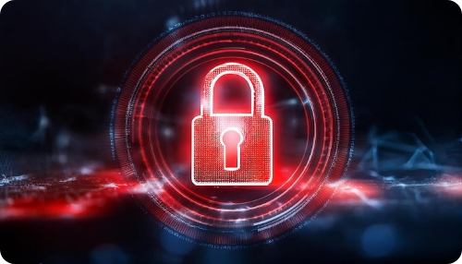

Don't Become the
Next Victim!
STOP
Think before clicking.
CHECK
Verify the source.
PROTECT
Keep your information secure.
References:
CISA | FBI Cyber Division | Official Corporate Incident Reports

Slide 9


Image Sources
https://irp.cdn-website.com/35fcf6c5/dms3rep/multi/Understanding+Social+Engineering+Penetration+Testing-e97c0b16.png
Source: www.threatintelligence.com
https://img.magnific.com/premium-photo/glowing-red-digital-lock-dark-smoky-backdrop-cybersecurity-online-safety-protection-3d-rendering_117466-54254.jpg?semt=ais_hybrid&w=740&q=80
Source: www.magnific.com

